Slide 1
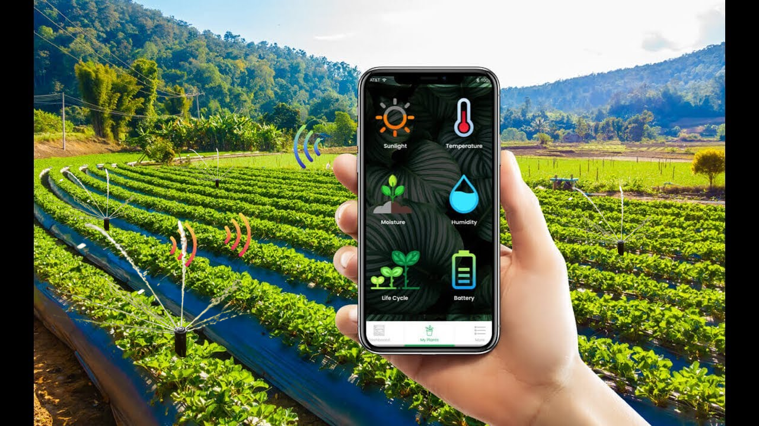
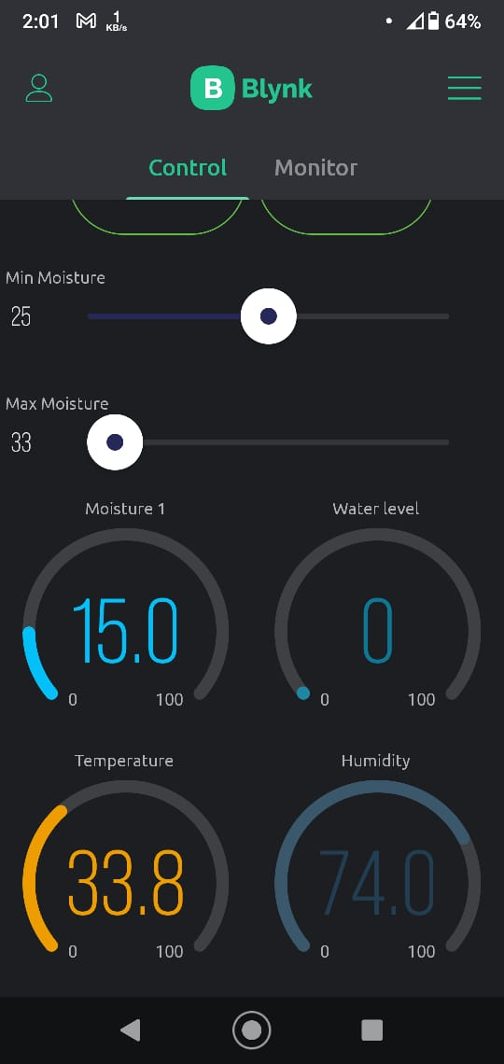
IoT Based Smart Irrigation System
Presented by: Group 1

Slide 2

Why Smart Irrigation System is Important?
“Farmers waste 800 litres of water to grow a kg of paddy”
- Dhaka Tribune (13 Jan, 2019)
Image: Mehedi Hasan/Dhaka Tribune

Slide 3

Project Objectives
State of the Art
Communication
System
Efficient Water Management
Reduce GHC Emission
Automation
Using
IoT

Slide 4




Features of our System
Supplies water
only when necessary
Web-based dashboard
to monitor important parameters
Both automatic
and manual control
Monitor & Control
from around the globe

Slide 5
Live Demonstration

Slide 6
Main Components
Node MCU ESP 8266
Submersible mini 12V water pump
Moisture Sensor
1 Channel 5V Relay Module
Ultrasonic Sensor
Temperature and Humidity Sensor

Slide 7
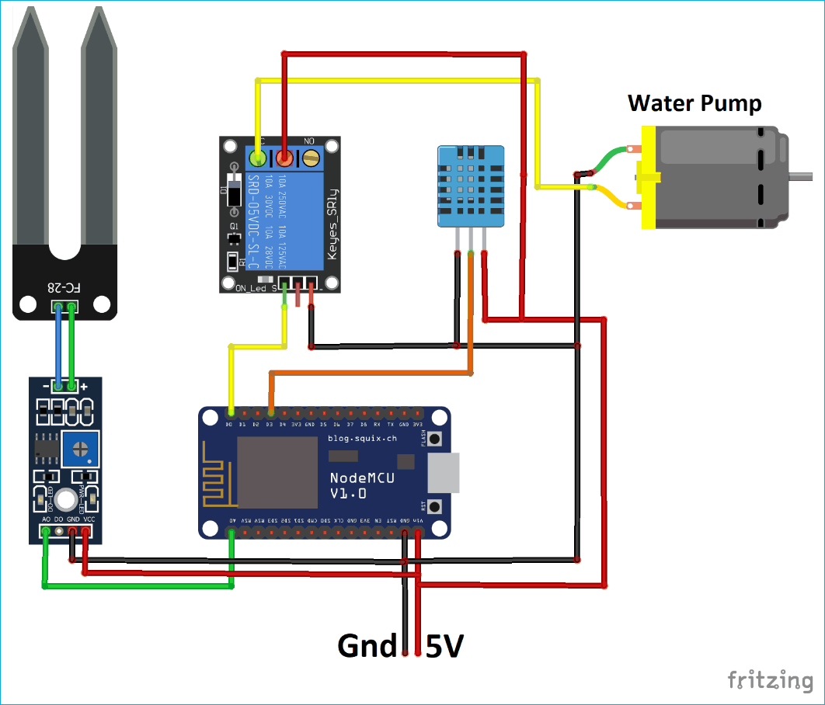
Circuit Diagram (Simplified)

Slide 8
Cost Analysis
Total Cost:
2260
BDT
Notes:
The total cost was 2260 taka. From the pi chart, we can see that Power Supply accounted for the maximum cost which is 24 %. Next to it, sensors and relays costed 23%. If we go for mass production, the overall cost can be further reduced.

Slide 9




Performance & Limitations
Latency
for Slow Internet
Wifi
Coverage
Issues
Declining
Sensor
Accuracy
Water Sensitive
Sonar Sensor

Slide 10


Future Prospects
Nutrient
Rain
pH
Pest
Crop Growth
Including weather
Forecast Information
More
Sensors
More
Automation

Slide 11




Contributions
Sajib Biswas Shuvo (131)
Coding, System Design
Tonmoy Hossain (136)
System Design, Hardware
Assembly
Supta Deb (154)
Hardware Assembly,
System Optimization
Syed Muid Al Kais (158)
Coding, Troubleshooting,
System Design

